Slide 1

Final Project Presentation
Airline Safety Ankara University Department of Interdisciplinary Artificial Intelligence Technologies
Melisa Gözet
21823408
Data and Information Visualization
${23}^{rd}$ May 2022

Slide 2
AGENDA
Data Intake Report
Data and Information Visualization
Information of Data

Slide 3

Data Intake Report
Data Storage Location : https://github.com/fivethirtyeight/data/tree/master/airline-safety
Tabular Data Details : airline-safety.csv
Source : Aviation Safety Network
Total number of observations | 56 Rows
Total number of files | 1
Total number of features | 8 Columns
Base format of the file | .csv
Size of the data | 3.6+ KB

Slide 4
Information of Data
Column | Definition
airline | Airline (asterisk indicates that regional subsidiaries are included)
avail_seat_km_per_week | Available seat kilometers flown every week
incidents_85_99 | Total number of incidents, 1985–1999
fatal_accidents_85_99 | Total number of fatal accidents, 1985–1999
fatalities_85_99 | Total number of fatalities, 1985–1999
incidents_00_14 | Total number of incidents, 2000–2014
fatal_accidents_00_14 | Total number of fatal accidents, 2000–2014
fatalities_00_14 | Total number of fatalities, 2000–2014

Slide 5
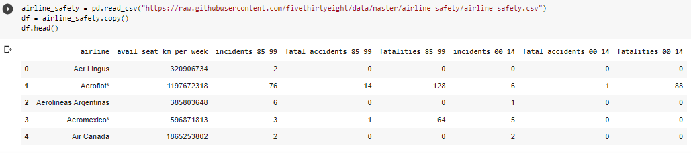

Slide 6
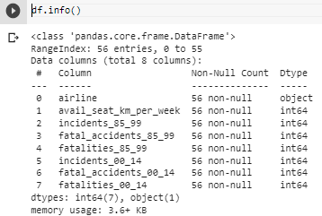
Column | Levels of Measurement
airline | Nominal
avail_seat_km_per_week | Interval
incidents_85_99 | Ratio
fatal_accidents_85_99 | Ratio
fatalities_85_99 | Ratio
incidents_00_14 | Ratio
fatal_accidents_00_14 | Ratio
fatalities_00_14 | Ratio

Slide 7
New Column | Definition | Levels of Measurement
total_incidents | incidents_85_99 + incidents_00_14 | Ratio
total_fatal_accidents | fatal_accidents_85_99 + fatal_accidents_00_14 | Ratio
total_fatalities | fatalities_85_99 + fatalities_00_14 | Ratio
fatal_accident_ratio | total_fatal_accidents / total_incidents | Ratio

Slide 8
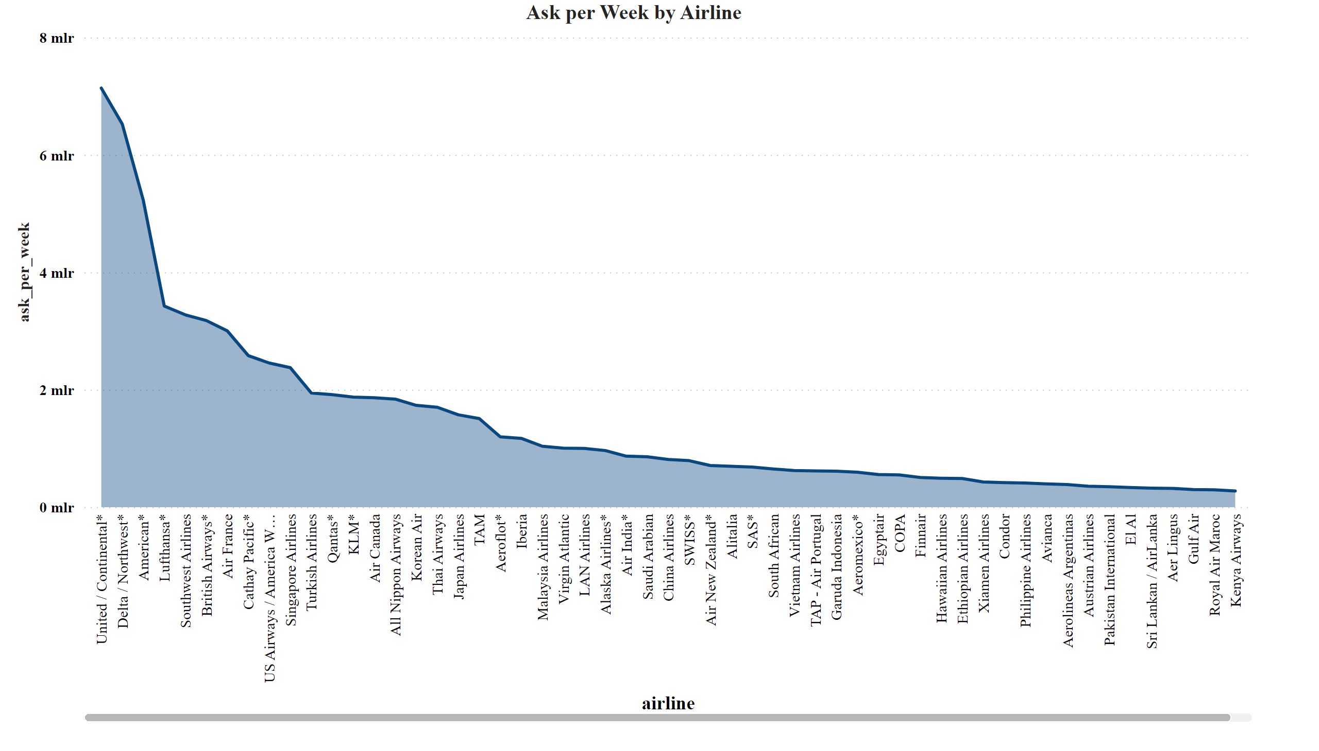

Slide 9
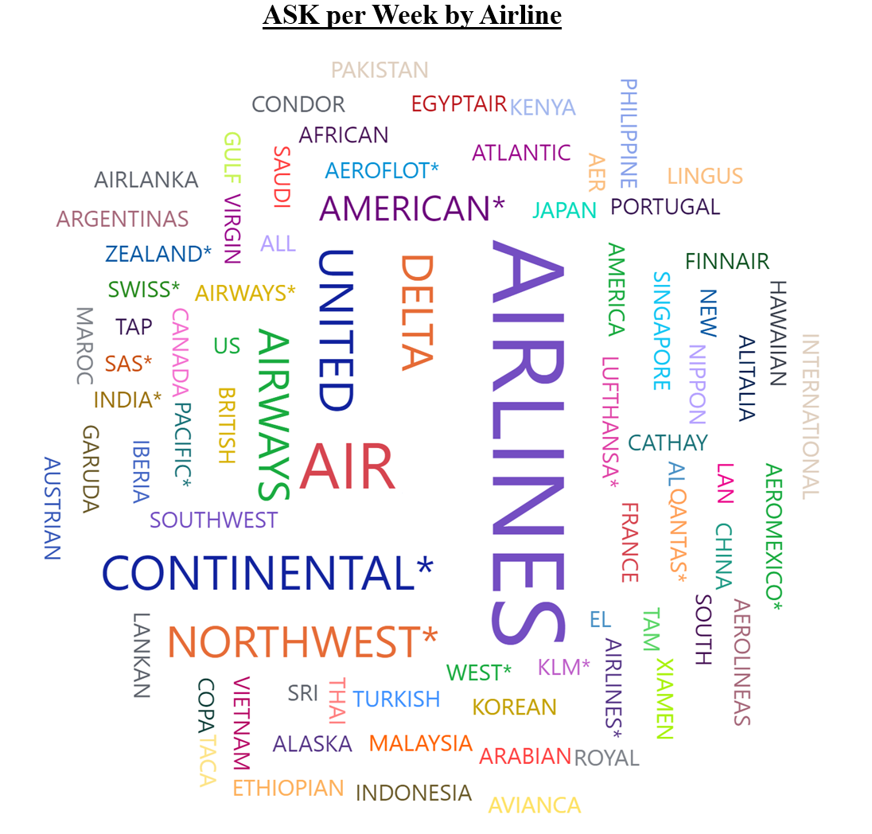

Slide 10
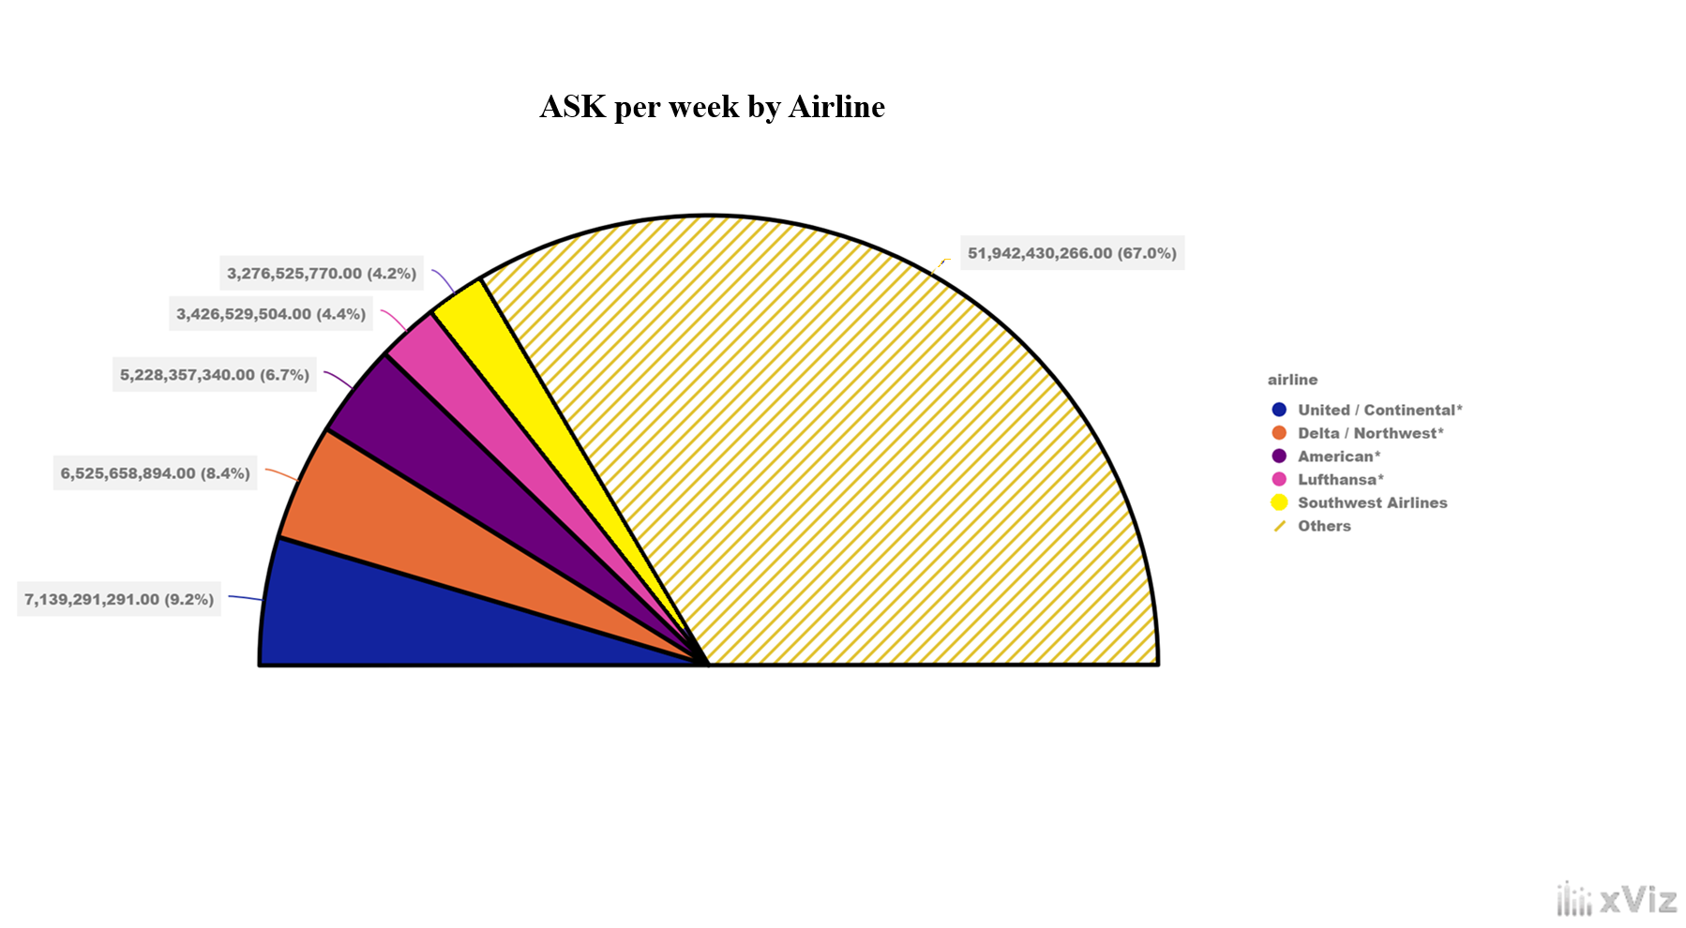

Slide 11
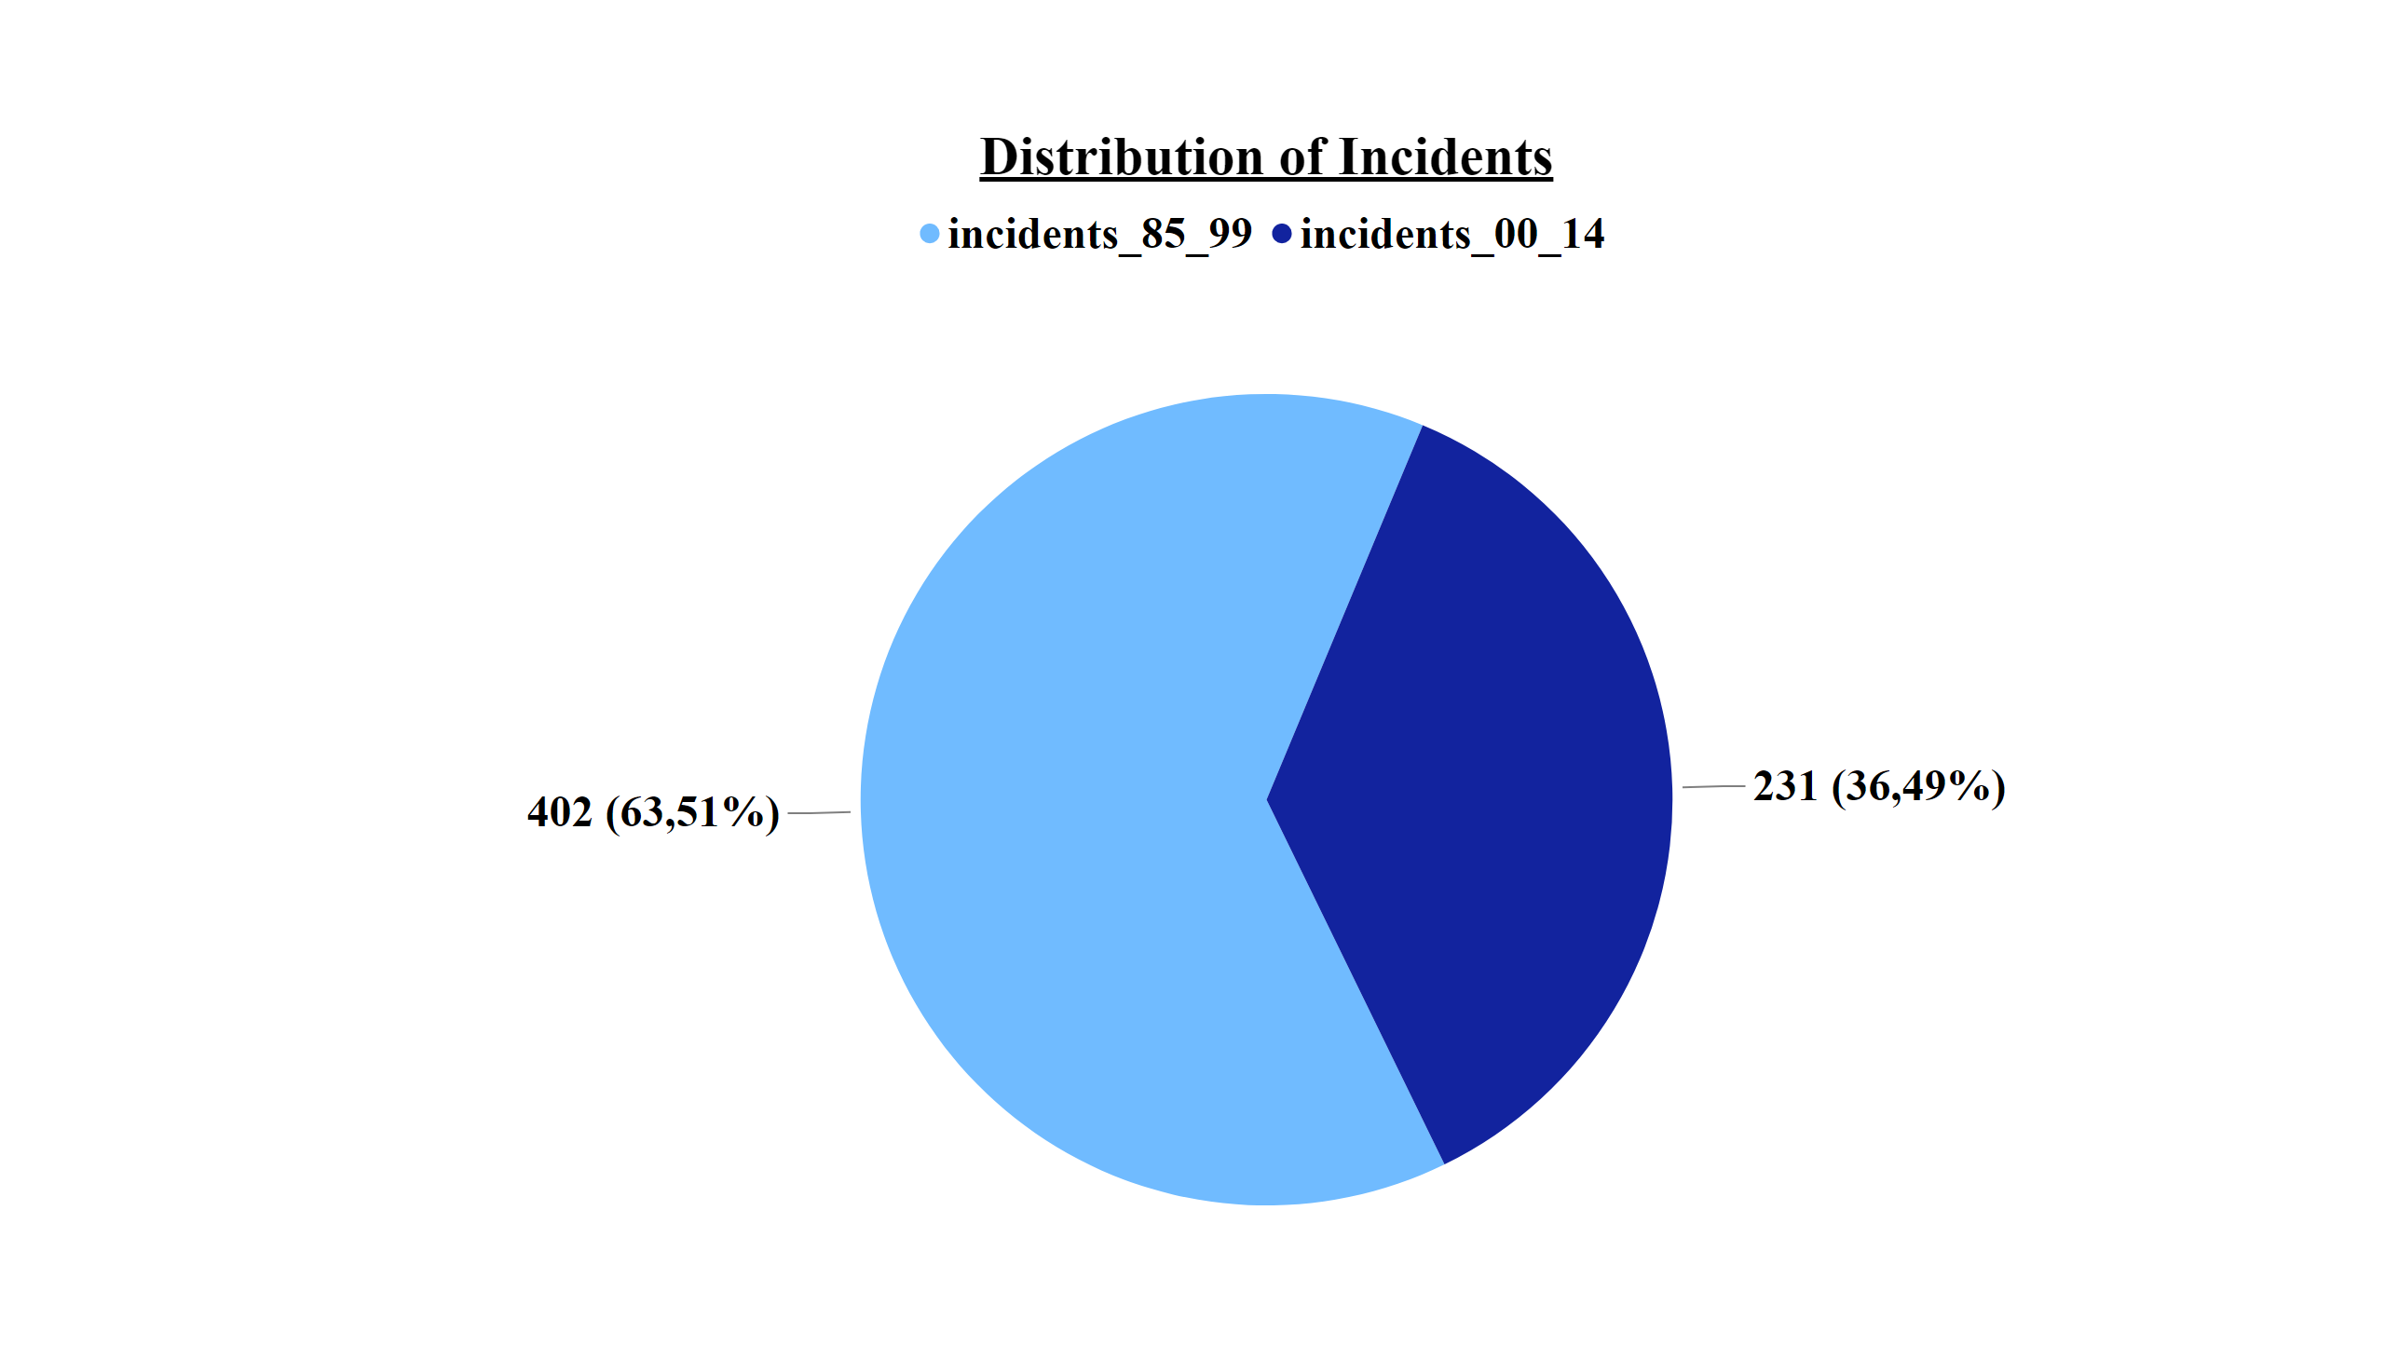

Slide 12
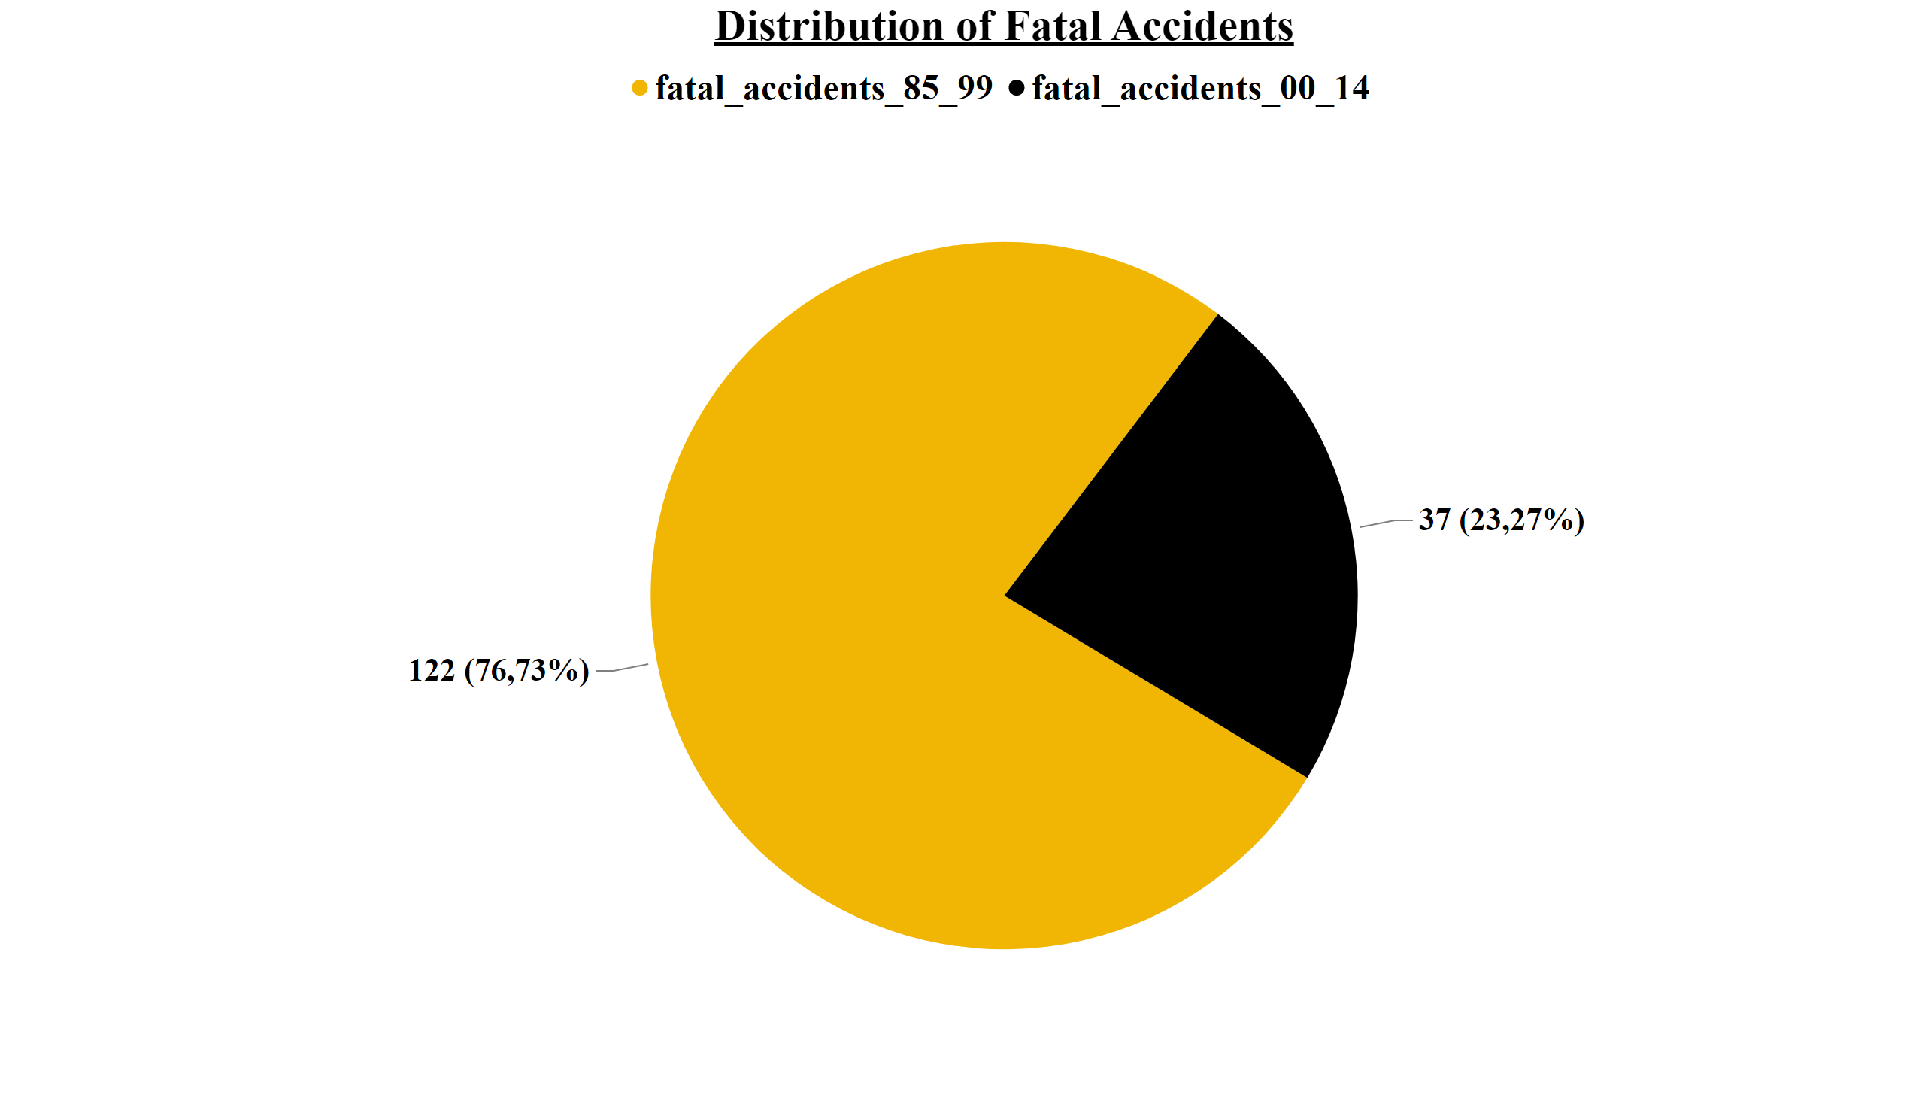

Slide 13
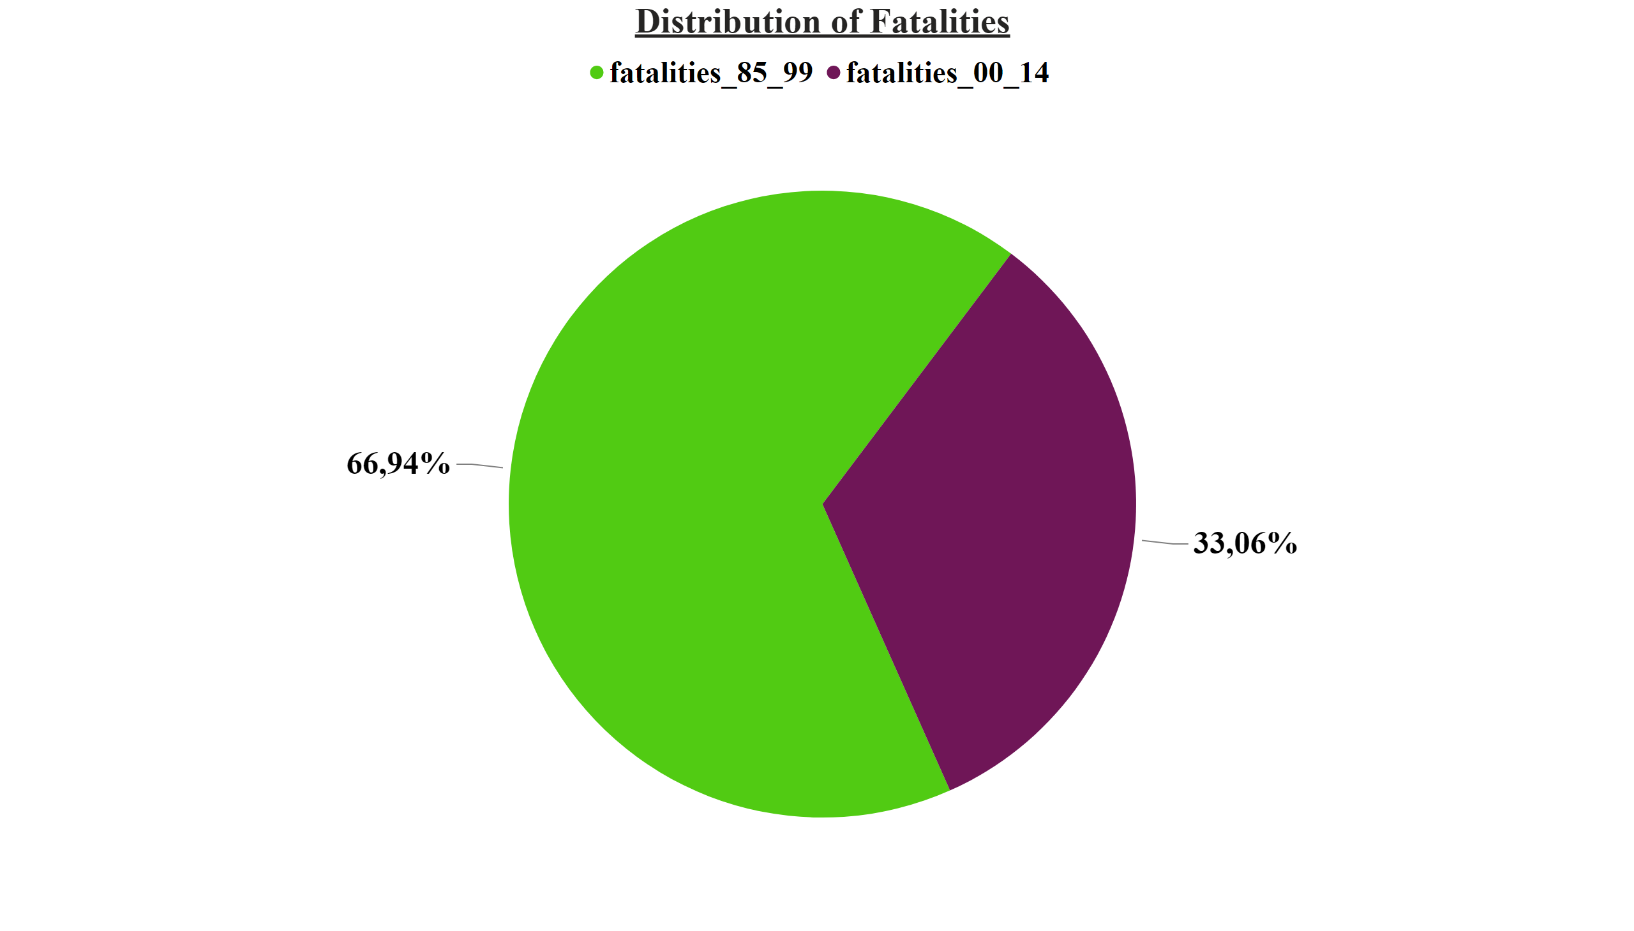

Slide 14
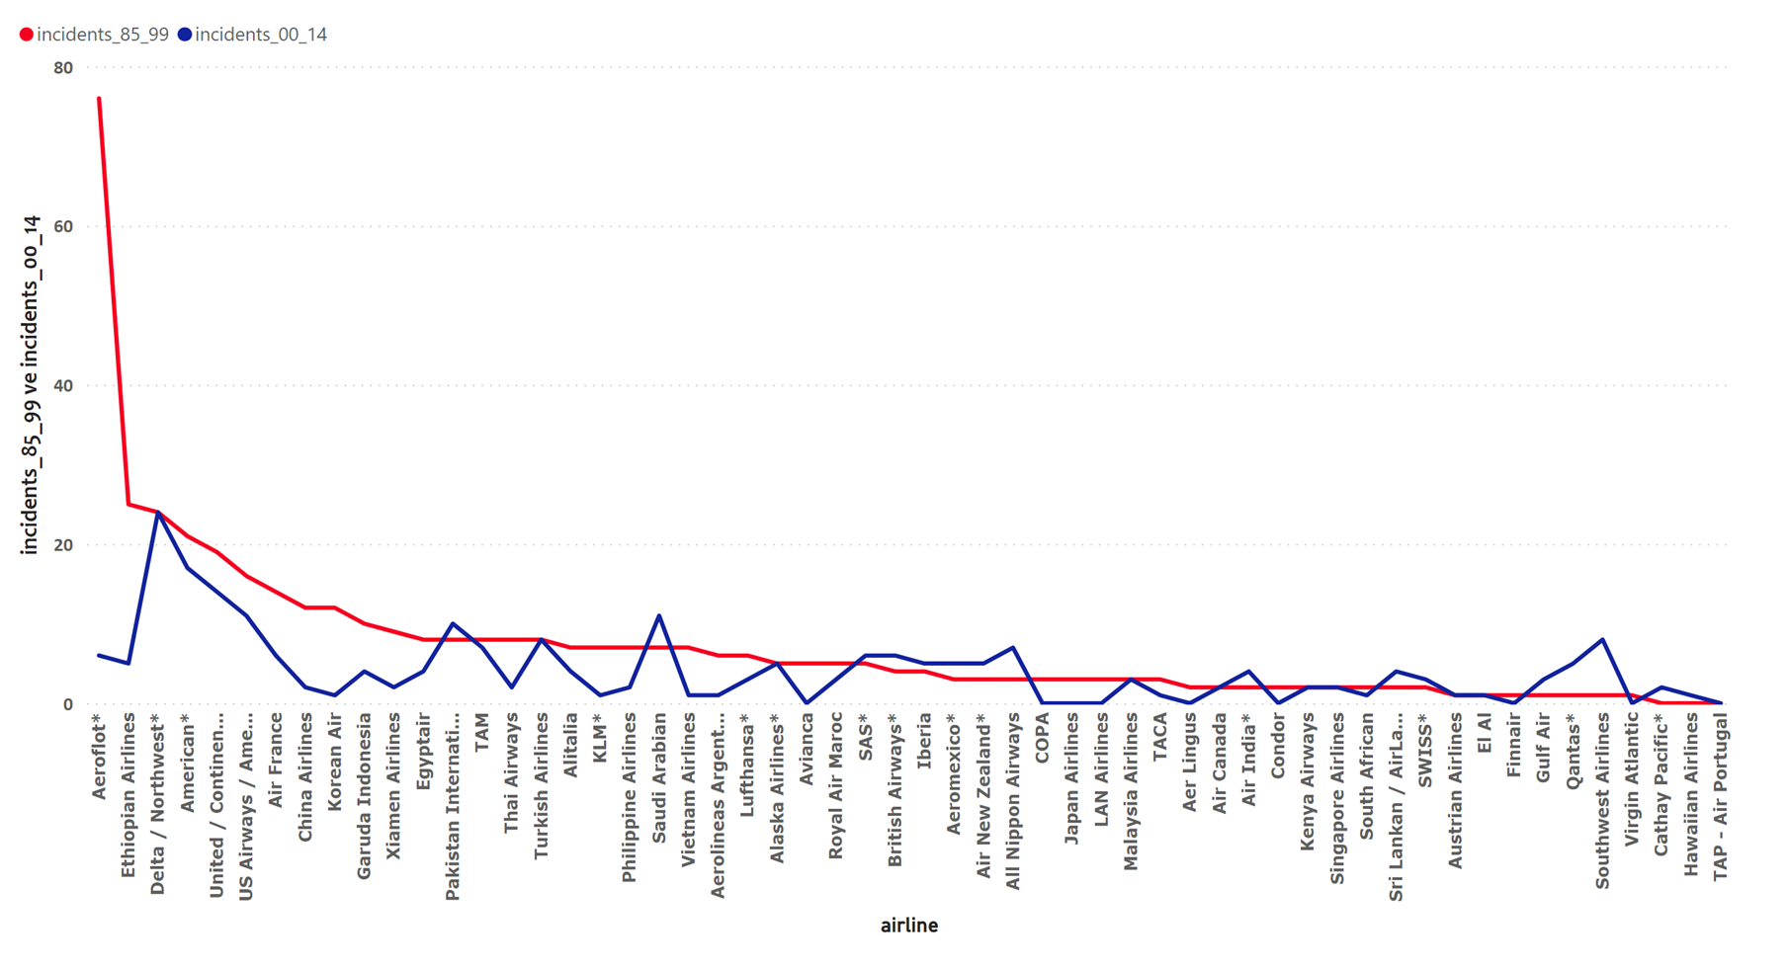

Slide 15
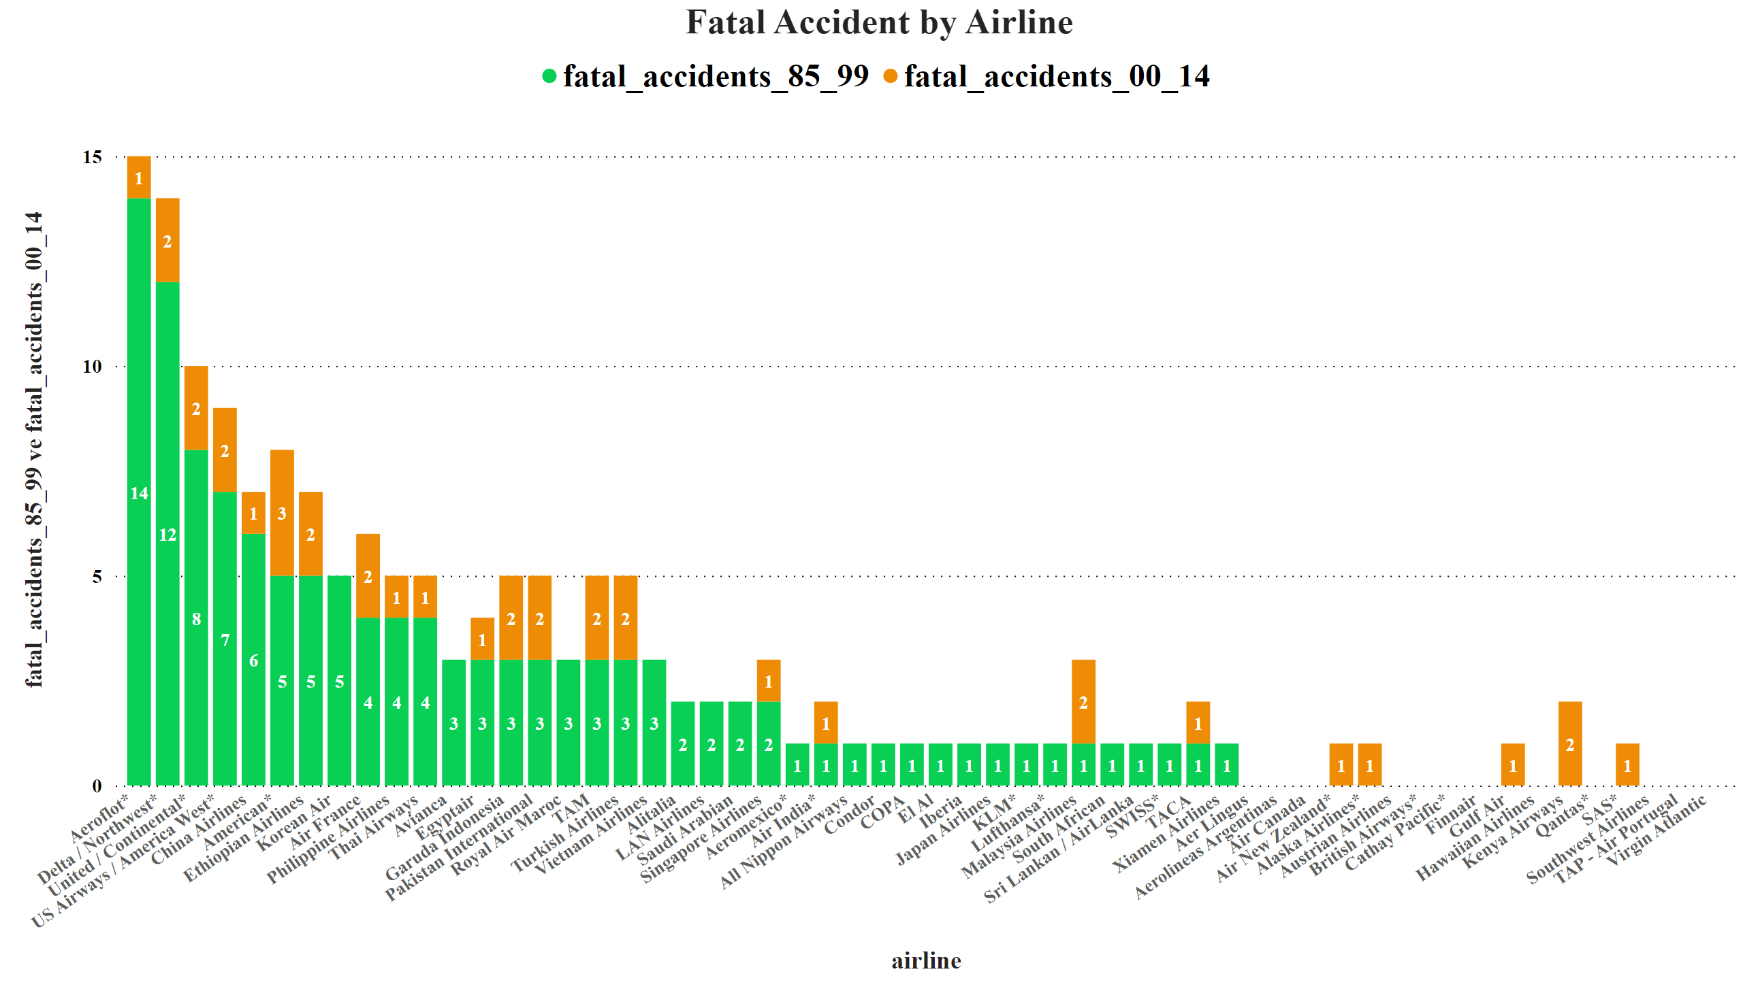

Slide 16
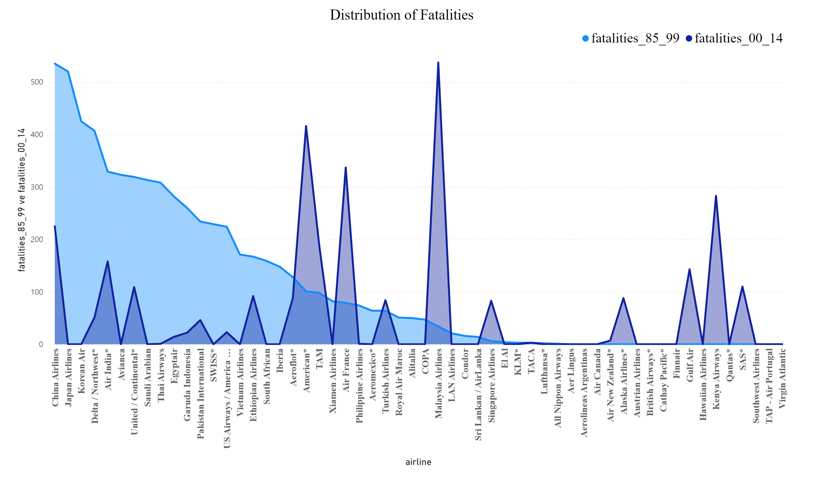

Slide 17
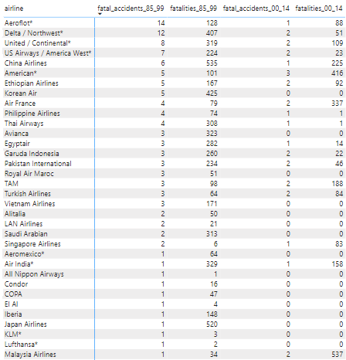
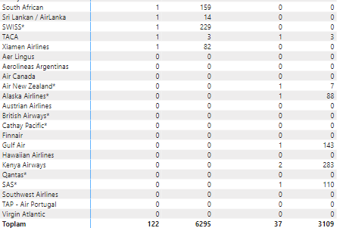

Slide 18
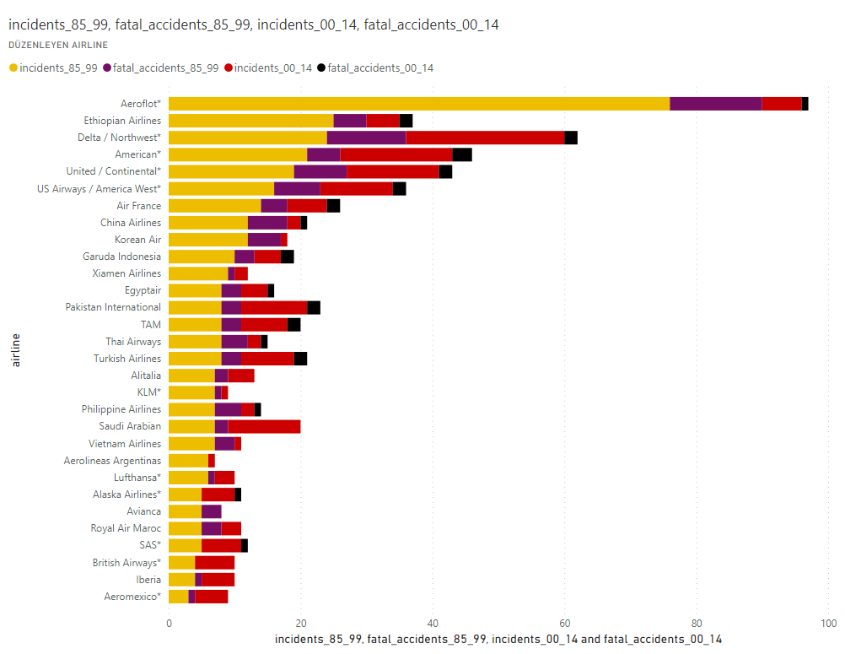

Slide 19
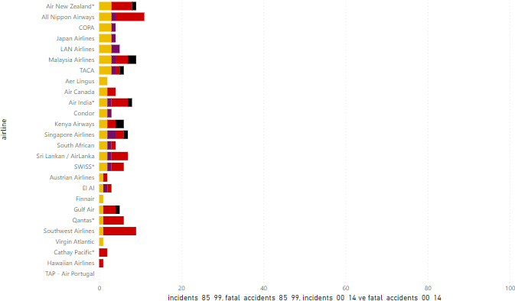

Slide 20
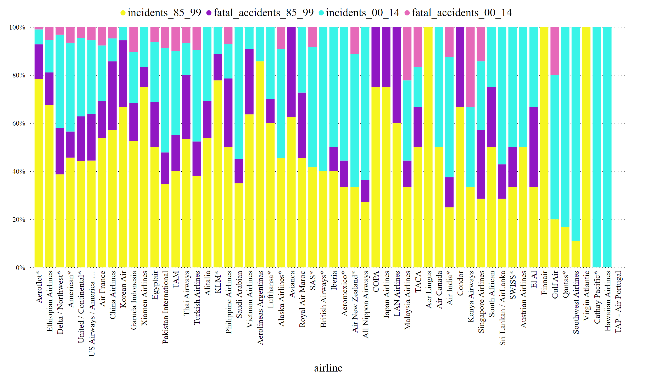

Slide 21
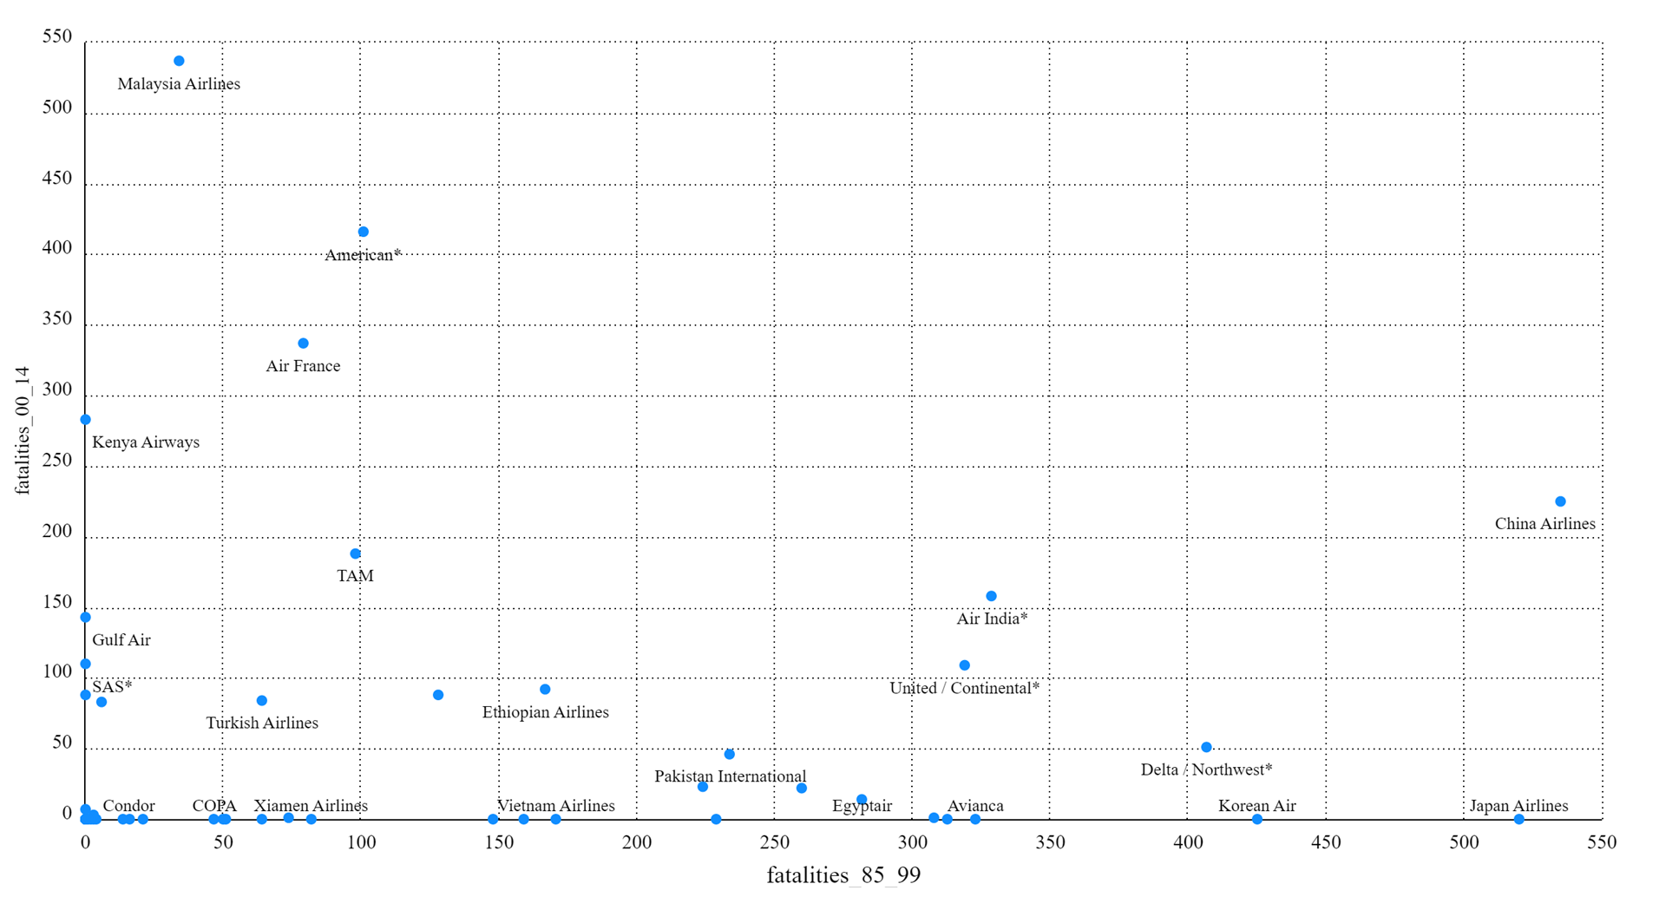

Slide 22
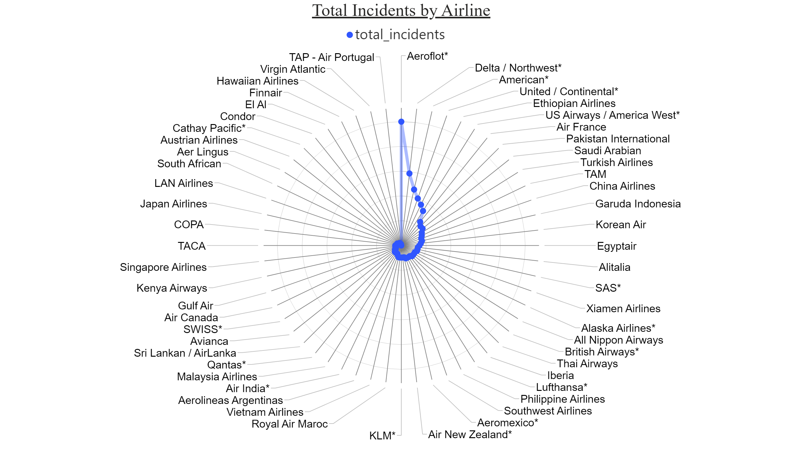

Slide 23
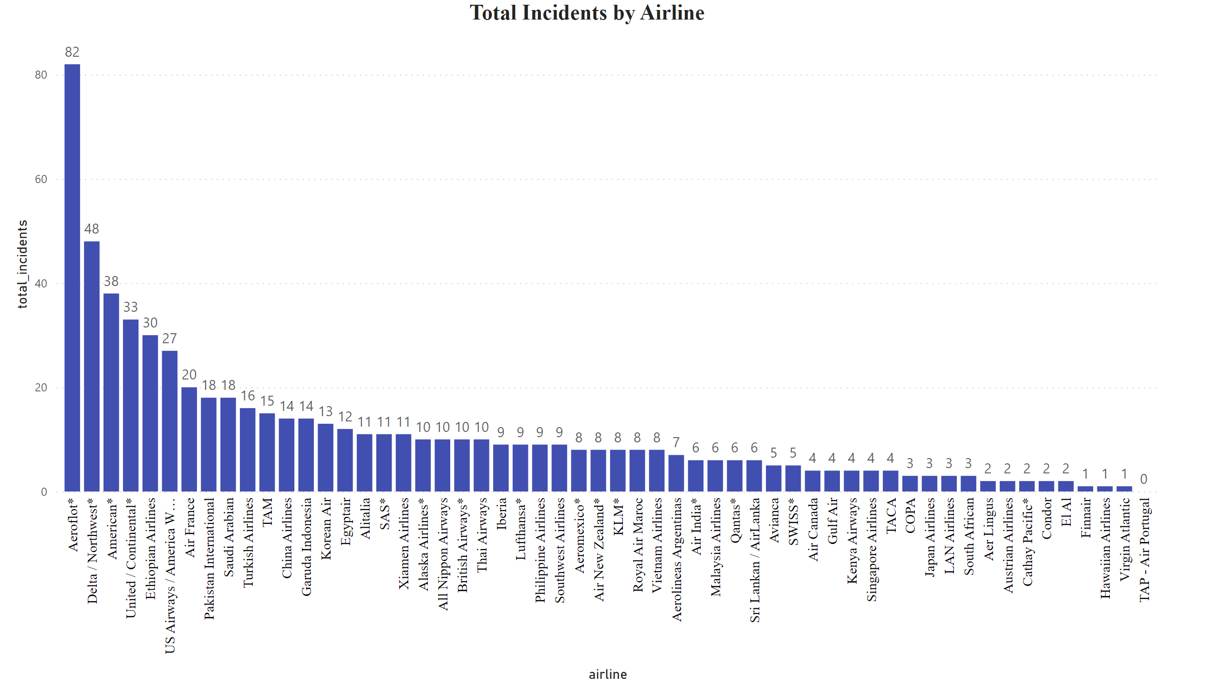

Slide 24
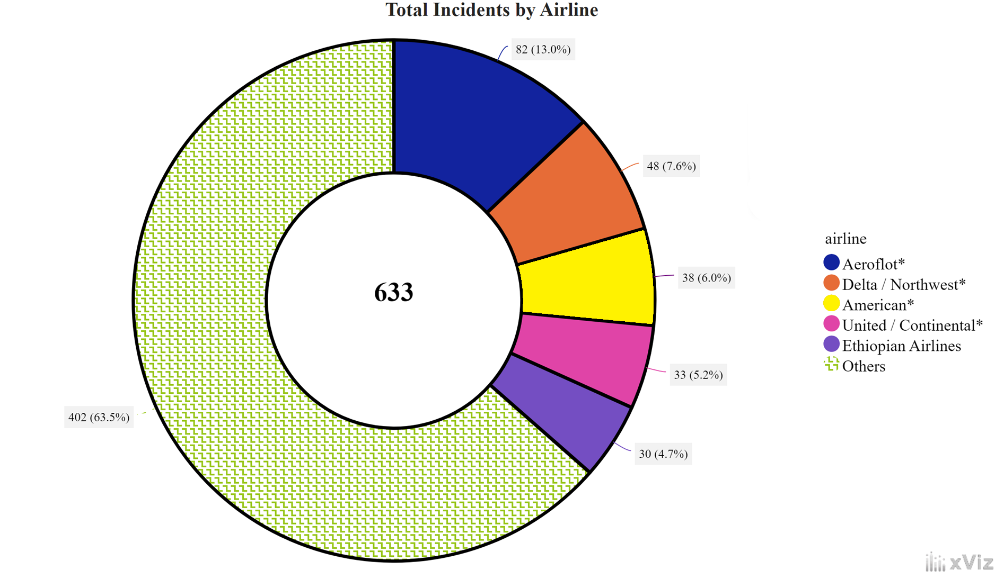

Slide 25
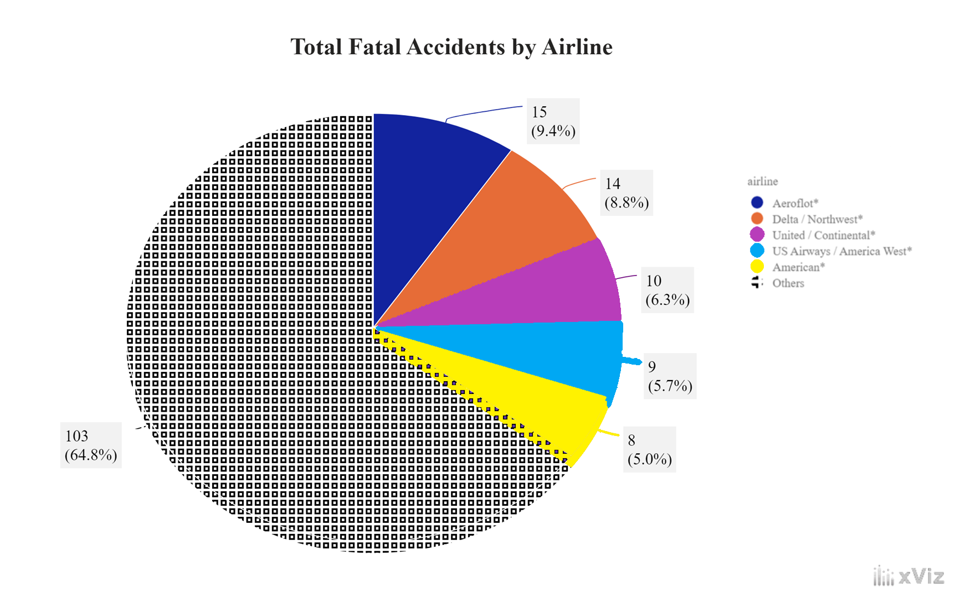

Slide 26
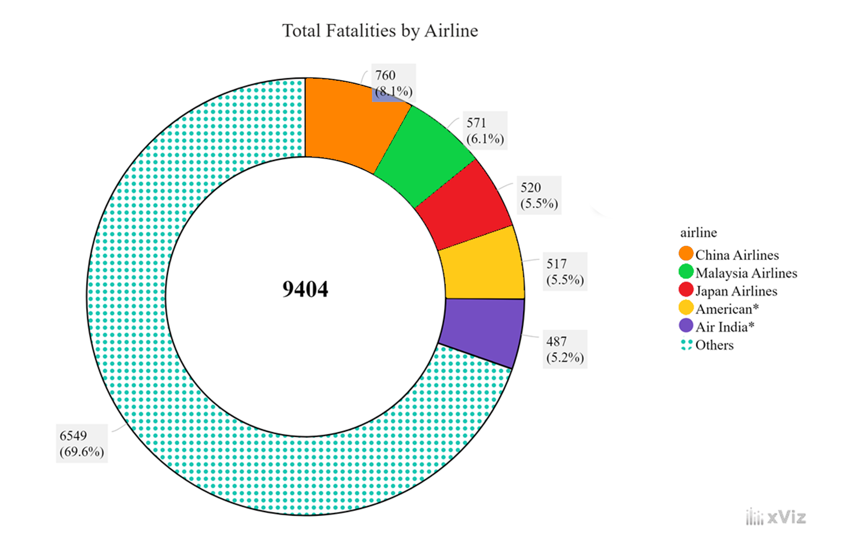

Slide 27
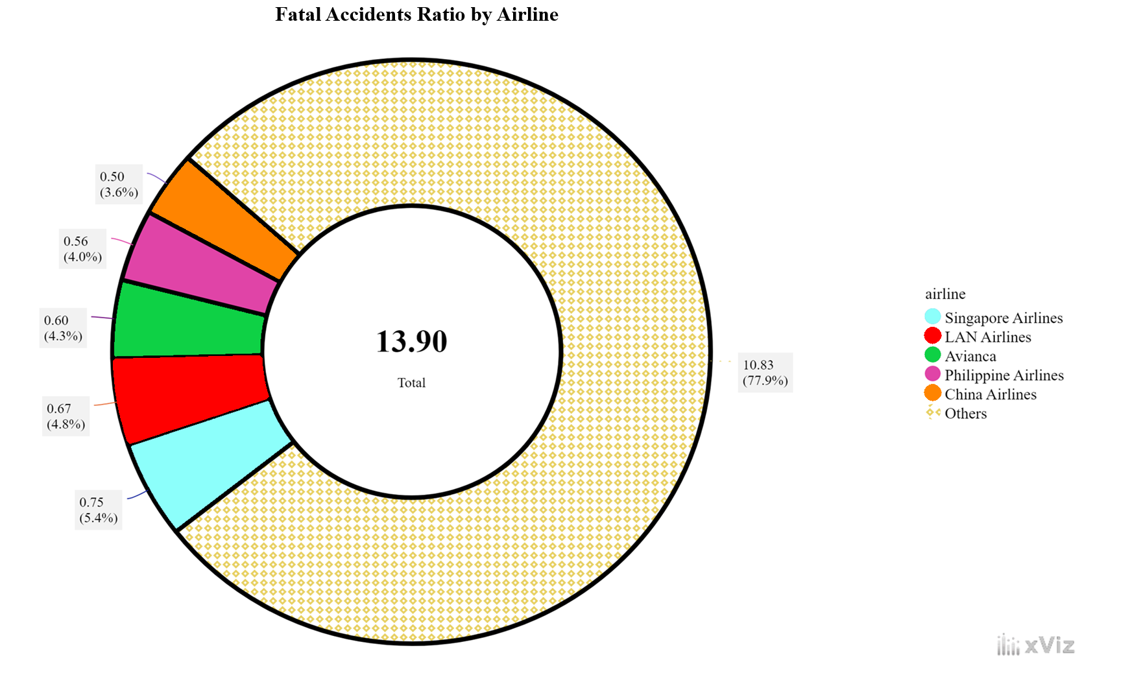

Slide 28
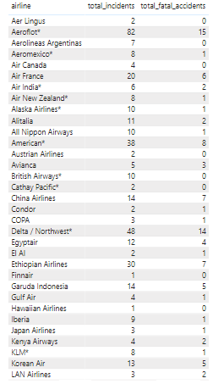
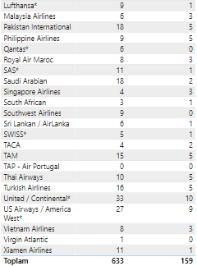

Slide 29
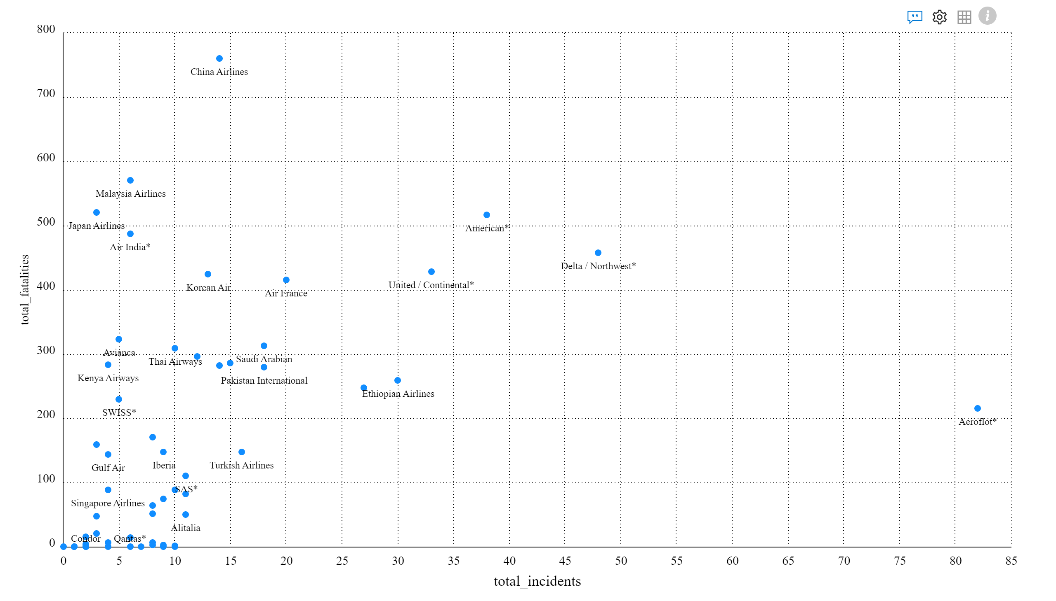

Slide 30
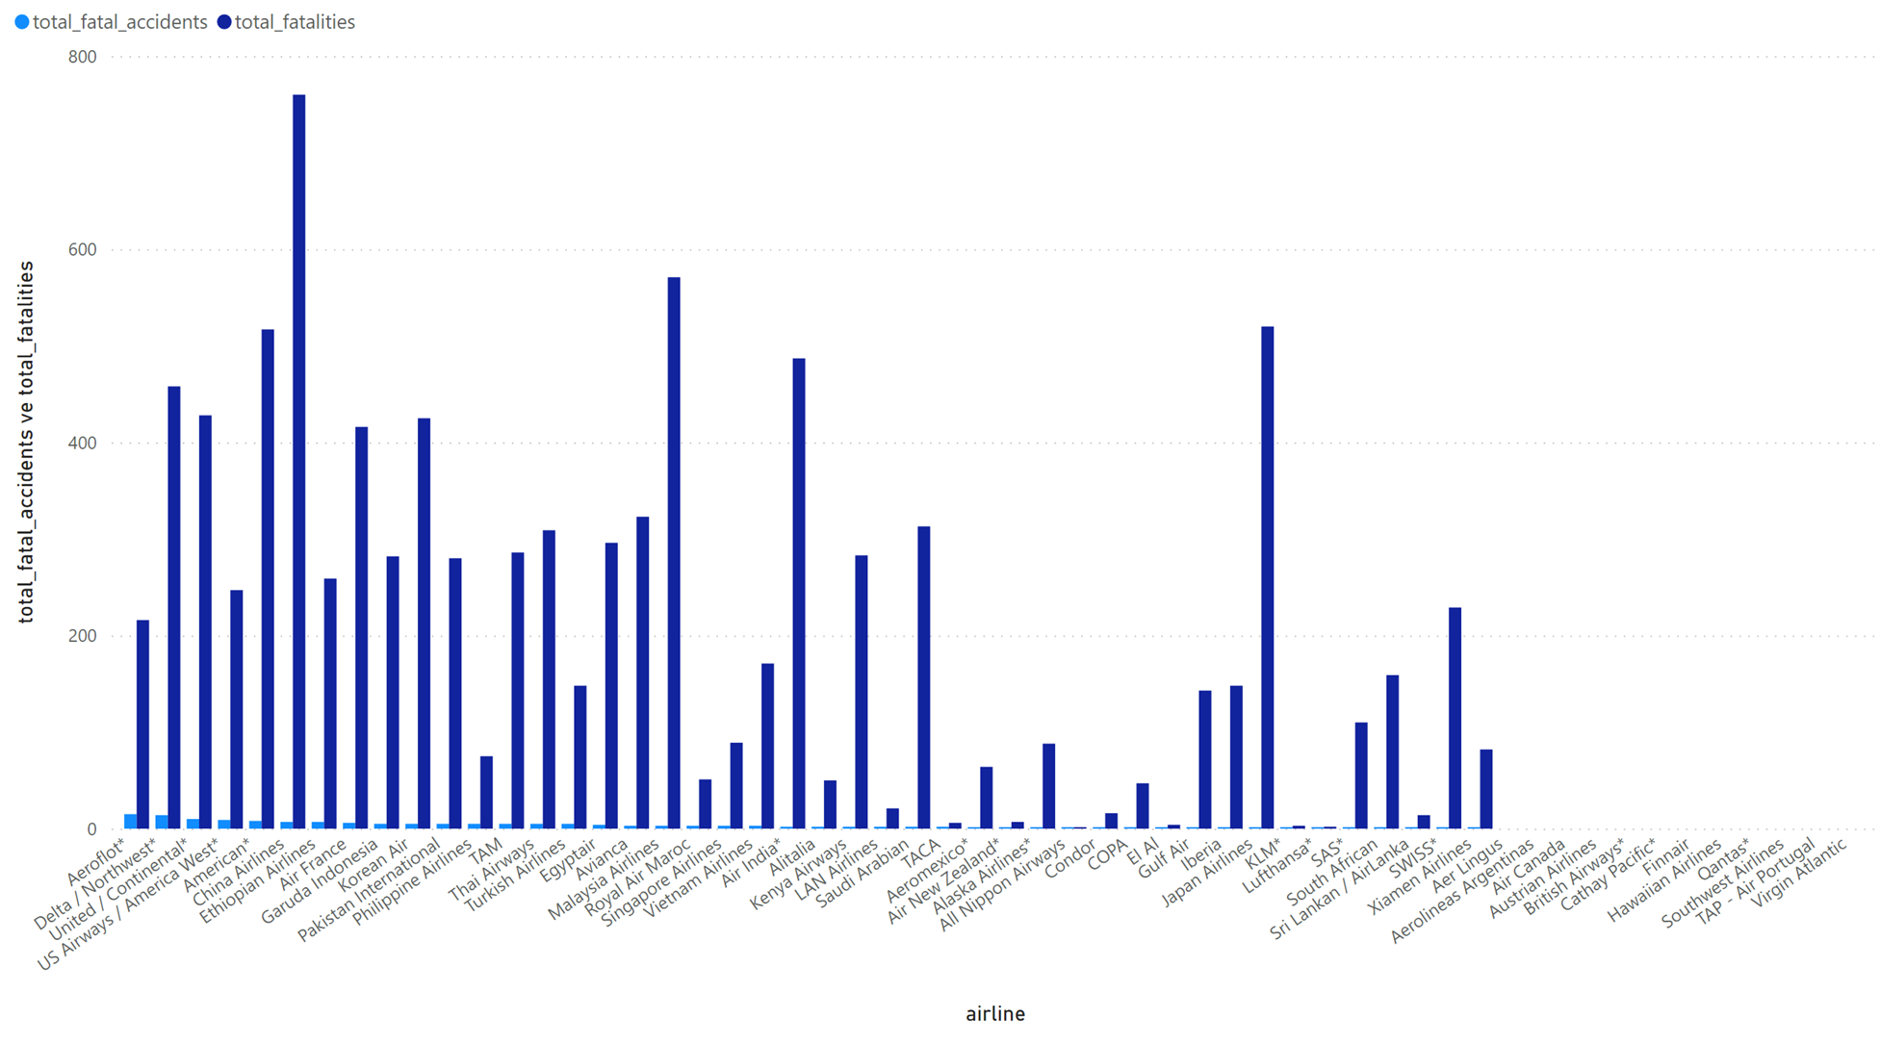

Slide 31
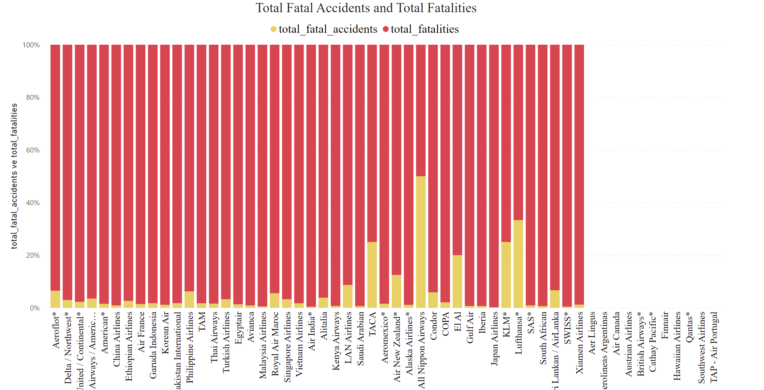

Slide 32
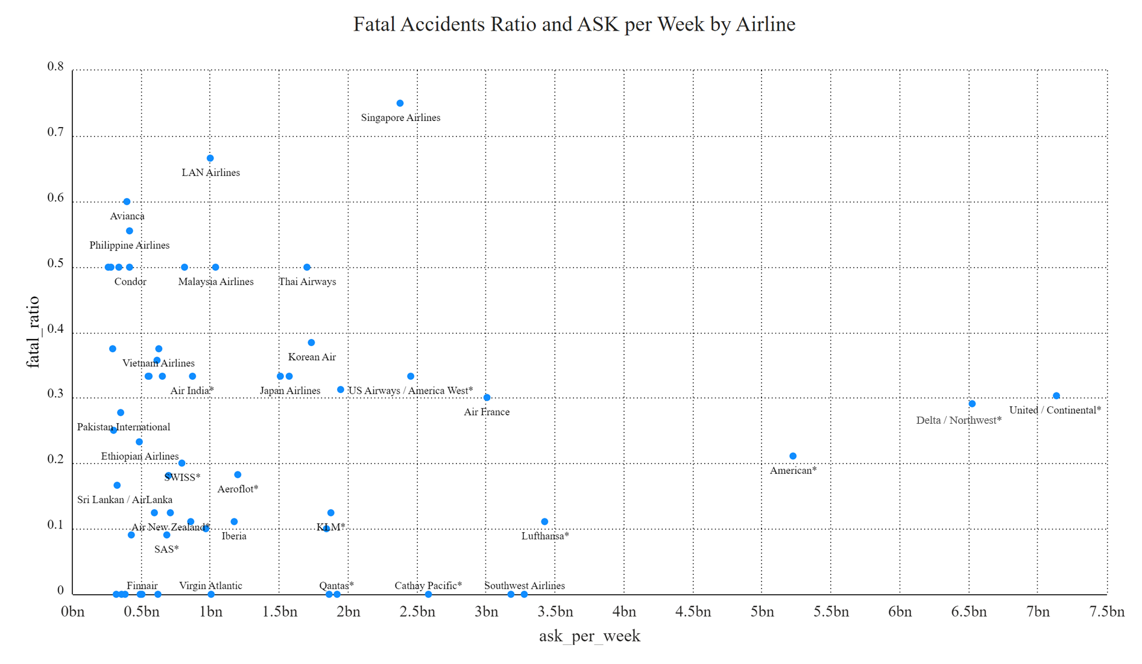

Slide 33
Thank You ☺

